Slide 1
LA Crime analysis
Naveen Vijayakumar

Slide 2
Agenda
Introduction
Dataset Overview
Preprocessing The Data
Data Analysis – Key Findings
Conclusion

Slide 3
Introduction
The dataset reflects the incidents of crime in LA from 2010 to present
The data is owned and provided by LAPD
Updated regularly to include the most recent data
Developed a python code to identify insights to control crime incidents
Crime data from 2010 to present
https://data.Lacity.Org/a-safe-city/crime-data-from-2010-to-present/y8tr-7khq

Slide 4
Dataset Overview
Large and complex dataset
1.62 million rows (records) - crime incidents
26 columns (attributes) - crime incident classifiers
Granular crime incident classifiers making the data very exhaustive (e.G. Types of weapons used, sub-categorization of crime type and premise description of incident)
Referred the data dictionary to understand the data

Slide 5
Data Analysis - Key findings
Top 5 safe and unsafe neighborhoods in L.A.
Weapon analysis (top 5 weapons used for any given crime)
Time of day analysis
Visualization of crimes in LA
Crimes against race (% of total number of crimes committed by race)

Slide 6
Preprocessing the data
Checked The Data Quality And Processed The Data In Python By
Removing Missing Values
Identifying And Eliminating Less Relevant Attributes
Omitted Attributes
Division of records (DR) number | Weapon used code | Crime code 4
Reporting district | Status code | Address
Crime code | Crime code 1 | Cross street
MO code | Crime code 2
Premise code | Crime code 2

Slide 7
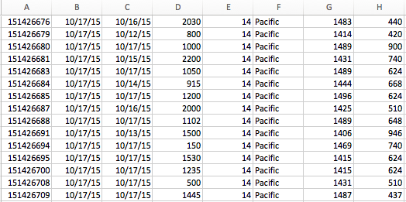
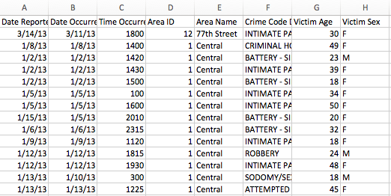
Preprocessing the data
After preprocessing the data, the dataset had
507,328 records
13 attributes
Before After

Slide 8
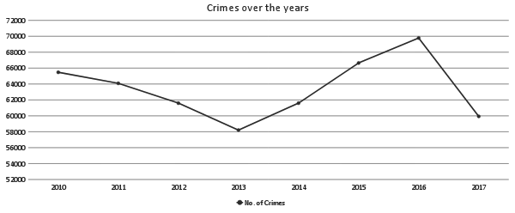
Crimes in LA - Overview

Slide 9
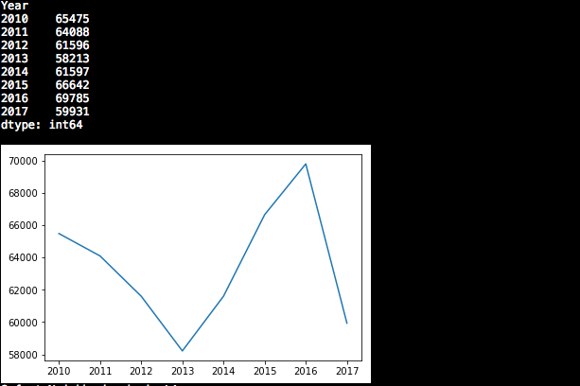
Output

Slide 10
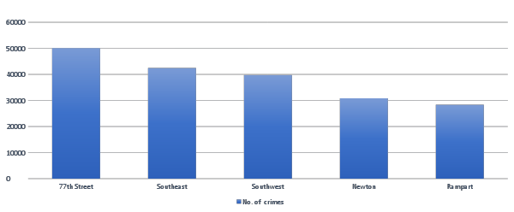
Unsafe Neighborhoods

Slide 11
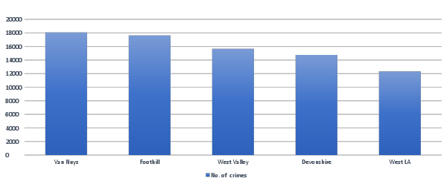
Safe Neighborhoods

Slide 12
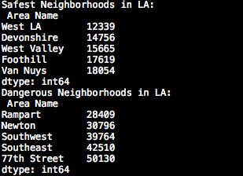
Output

Slide 13
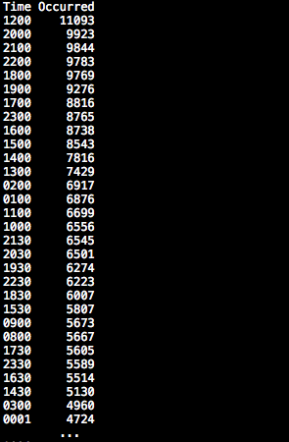
Time of day analysis
Dataset
Time of occurrence of the each crime is given
Plan
Categories into 6 buckets and understand when most crimes occur during the day
Hypothesis
Most crimes occur at night

Slide 14
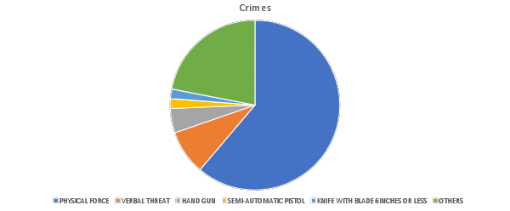
Weapons Used Analysis

Slide 15
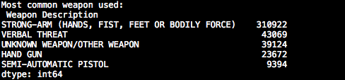
OUTPUT

Slide 16
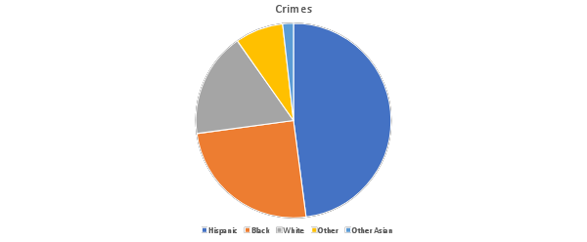
Crimes against Race
A - Other Asian
B - Black
C - Chinese
D - Cambodian
F - Filipino
G - Guamanian
H - Hispanic/Latin/Mexican
I - American Indian/Alaskan Native
J - Japanese
K - Korean
L - Laotian
O - Other
P - Pacific Islander
S - Samoan
U - Hawaiian
V - Vietnamese
W - White
X - Unknown
Z - Asian Indian

Slide 17
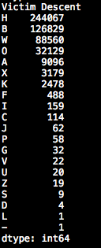
OUTPUT
A - Other Asian
B - Black
C - Chinese
D - Cambodian
F - Filipino
G - Guamanian
H - Hispanic/Latin/Mexican
I - American Indian/Alaskan Native
J - Japanese
K - Korean
L - Laotian
O - Other
P - Pacific Islander
S - Samoan
U - Hawaiian
V - Vietnamese
W - White
X - Unknown
Z - Asian Indian

Slide 18
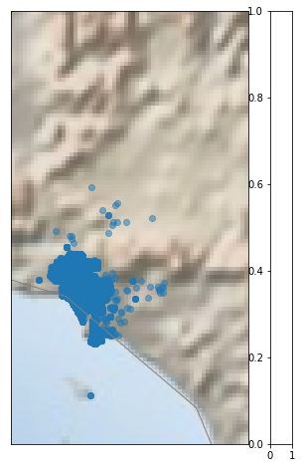
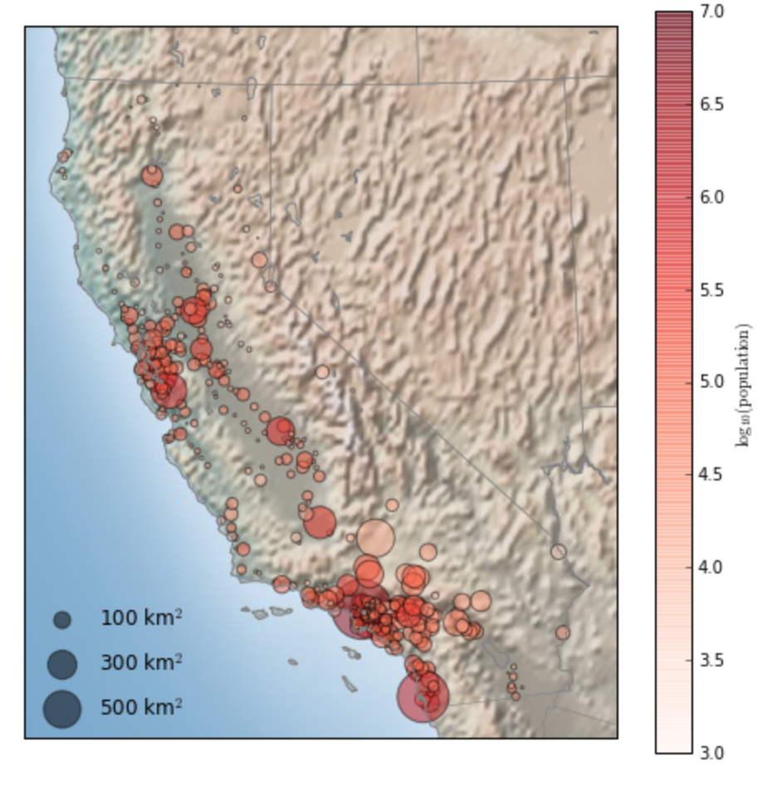
Visualization of Crimes in LA

Slide 19
Questions???

